Slide 1
AWS
By: Anuj Khasgiwala

Slide 2

Introduction
What is ?
What is Cloud Computing?

Slide 3
Why AWS?
Flexible
Cost-effective
Scalable and elastic
Secure
Experienced

Slide 4
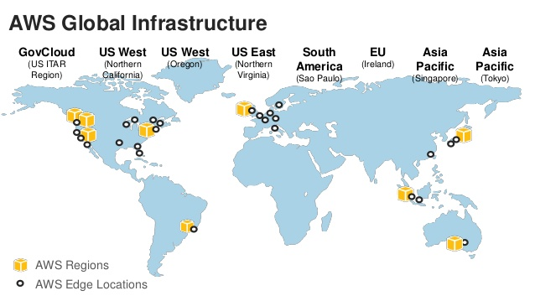
Architecture
Region
Zone
Edge Locations
New Regions announced
Isolation

Slide 5
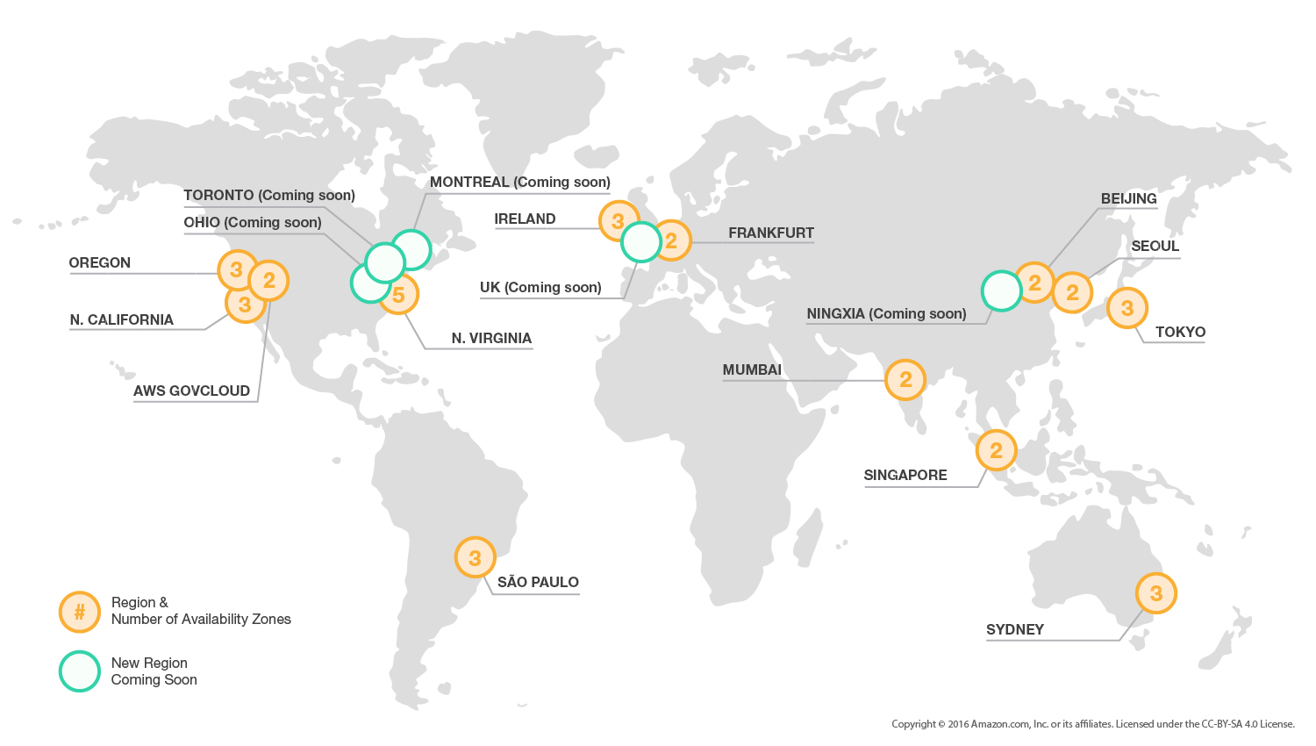
Architecture

Slide 6
Let’s Get Started
Setup an AWS account
https://www.youtube.com/watch?v=QprZdLTTEb4

Slide 7
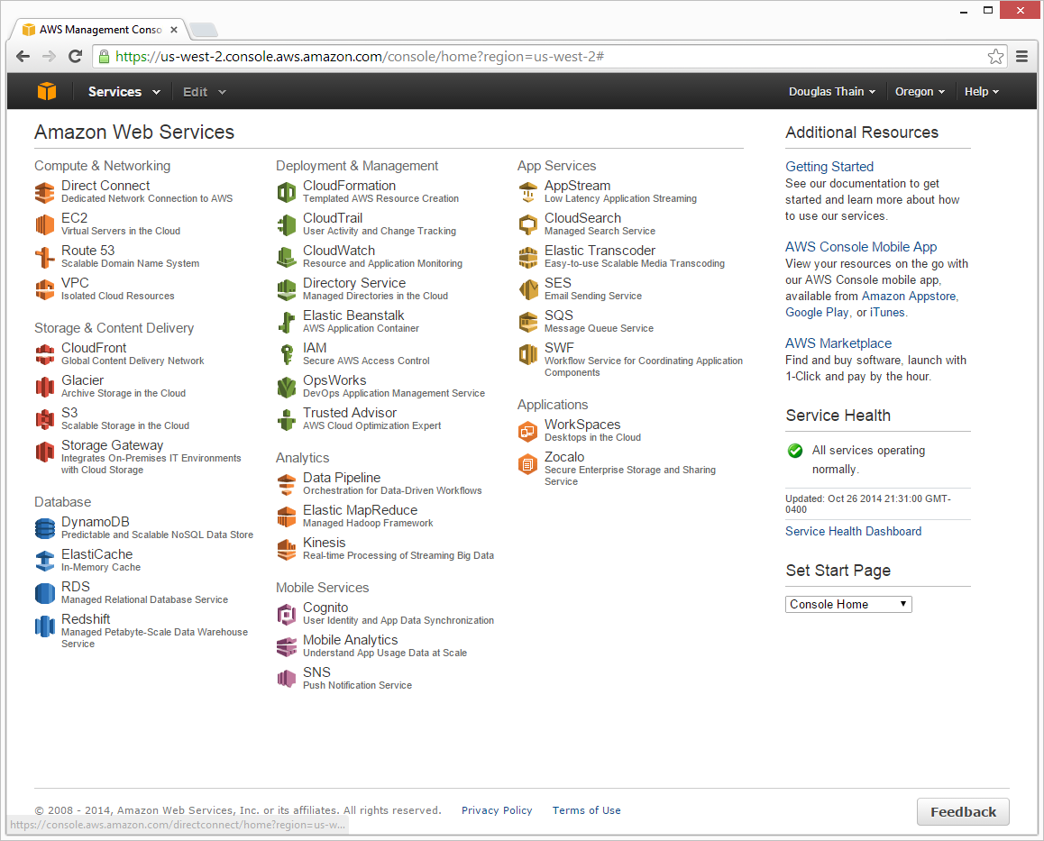

Slide 8




AWS Services
What is (EC2)?
What is (S3)?
What is (IAM)?
What is (Dynamo DB)?

Slide 9
S3 with EC2

Slide 10
Reference
https://aws.amazon.com/
https://d36cz9buwru1tt.cloudfront.net/AWS_Overview.pdf
https://www.cloudendure.com/blog/nine-must-view-aws-presentations/
https://en.wikipedia.org/wiki/Amazon_Web_Services
http://docs.aws.amazon.com/AWSEC2/latest/UserGuide/AmazonS3.html
http://cloudacademy.com/blog/how-to-deploy-application-code-from-s3-using-aws-codedeploy/

Slide 11


